Slide 1
BE A GUITARIST : WEBSITE
A GUIDE TO BEGINNERS

Slide 2
Contents
INTRODUCTION
PRIMARY GOALS
AREAS OF GROWTH
TECHNOLOGY USED
SUMMARY

Slide 3
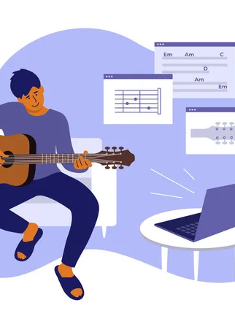
Introduction
This is a website for beginners who wish to learn guitar be a fluent guitarists. Being a guitarist I know the hardships and difficulties faced by the beginner guitarists in India when thy just start off with their love for music.
This website is for anyone who wish to learn guitar, it contains all the necessary information needed by a beginner in this field, from buying guides to buying links and video lessons to chord library everything is well curated.
This website is made using HTML and CSS and is user friendly providing an ease interface to the users.

Slide 4
Primary Goals
Help beginners to learn music with an ease on internet with this website.
Providing all the necessary link and videos required for any guitarist.
Providing a chord library with a vast collection of chords for the users
We also provide a initial buying guid for the beginners purchasing a guitar for the first time.

Slide 5
Areas of Growth
With further work the website can also be used as an online learning platform with various courses to purchase at an optimal price.
Starting off with guitars, the website can be further converted to site for almost every instrument with courses available.
Website can be used for Affiliate Marketing by directing the users to various E-Commerce website for purchasing their instruments.

Slide 6
Technology Used
HTML is used to build the basic structure for the website.
CSS is further used for styling and giving the website a better look and interface
Proper links are used to YouTube and Amazon for Affiliate purpose in order to generate Revenue.
Taken a proper care of SEO for the maximum traffic on the website.

Slide 7
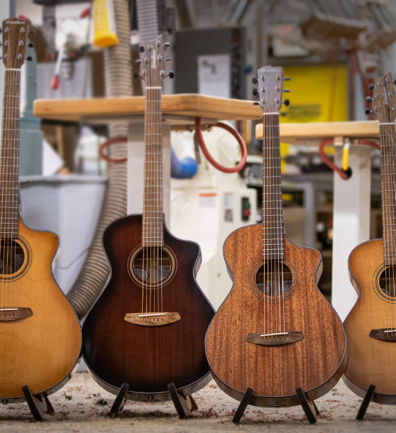
Summary
Learning something new is always difficult. This website just simply tries to make it simple by providing the required necessities of a beginner and trying best to fulfill them. Providing all the links, guides and libraries so that the user will feel no need to go anywhere else.

Slide 8
Thank You
Shariq Khan
2002220100148
Section - C1

